Slide 1




overall_1_132573879104528179 columns_1_132573879104528179
Microsoft Office Add-ins
Community call
Open in Excel pattern
Use Linq-to-XML in Office Add-ins
Community engagement update
Outlook API update on REST decommission and Mailbox 1.12 Scope
August 10, 2022

Slide 2
Agenda
Open in Excel pattern
Use Linq-to-XML in Office Add-ins
Community engagement update
Outlook API update
Yawei Zhu
Thomas Barnekow
Linda Cannon
Juan Balmori
Senior Product Manager
Senior Principal Architect
Senior Content Product Manager
Principal Product Manager

Slide 3
Excel add-in pattern and APIs
Yawei Zhu: Senior Product Manager

Slide 4
Proposal of a User Pattern Open in Excel
Excel add-in PM: Yawei Zhu

Slide 5
User Journey
Traditional Way
Open add-in office store
Install the add-in
Launch add-in
Step 2
Step 4
Step 6
Step 1
Search add-in in office store
Step 3
Switch to the ribbon
Step 5
Use it!
Open in Excel Pattern
Click open in Excel button from your own system
Use it!
Step 2
Step 1
Open file in Excel
Install and launch add-in automatically
Step 3

Slide 6
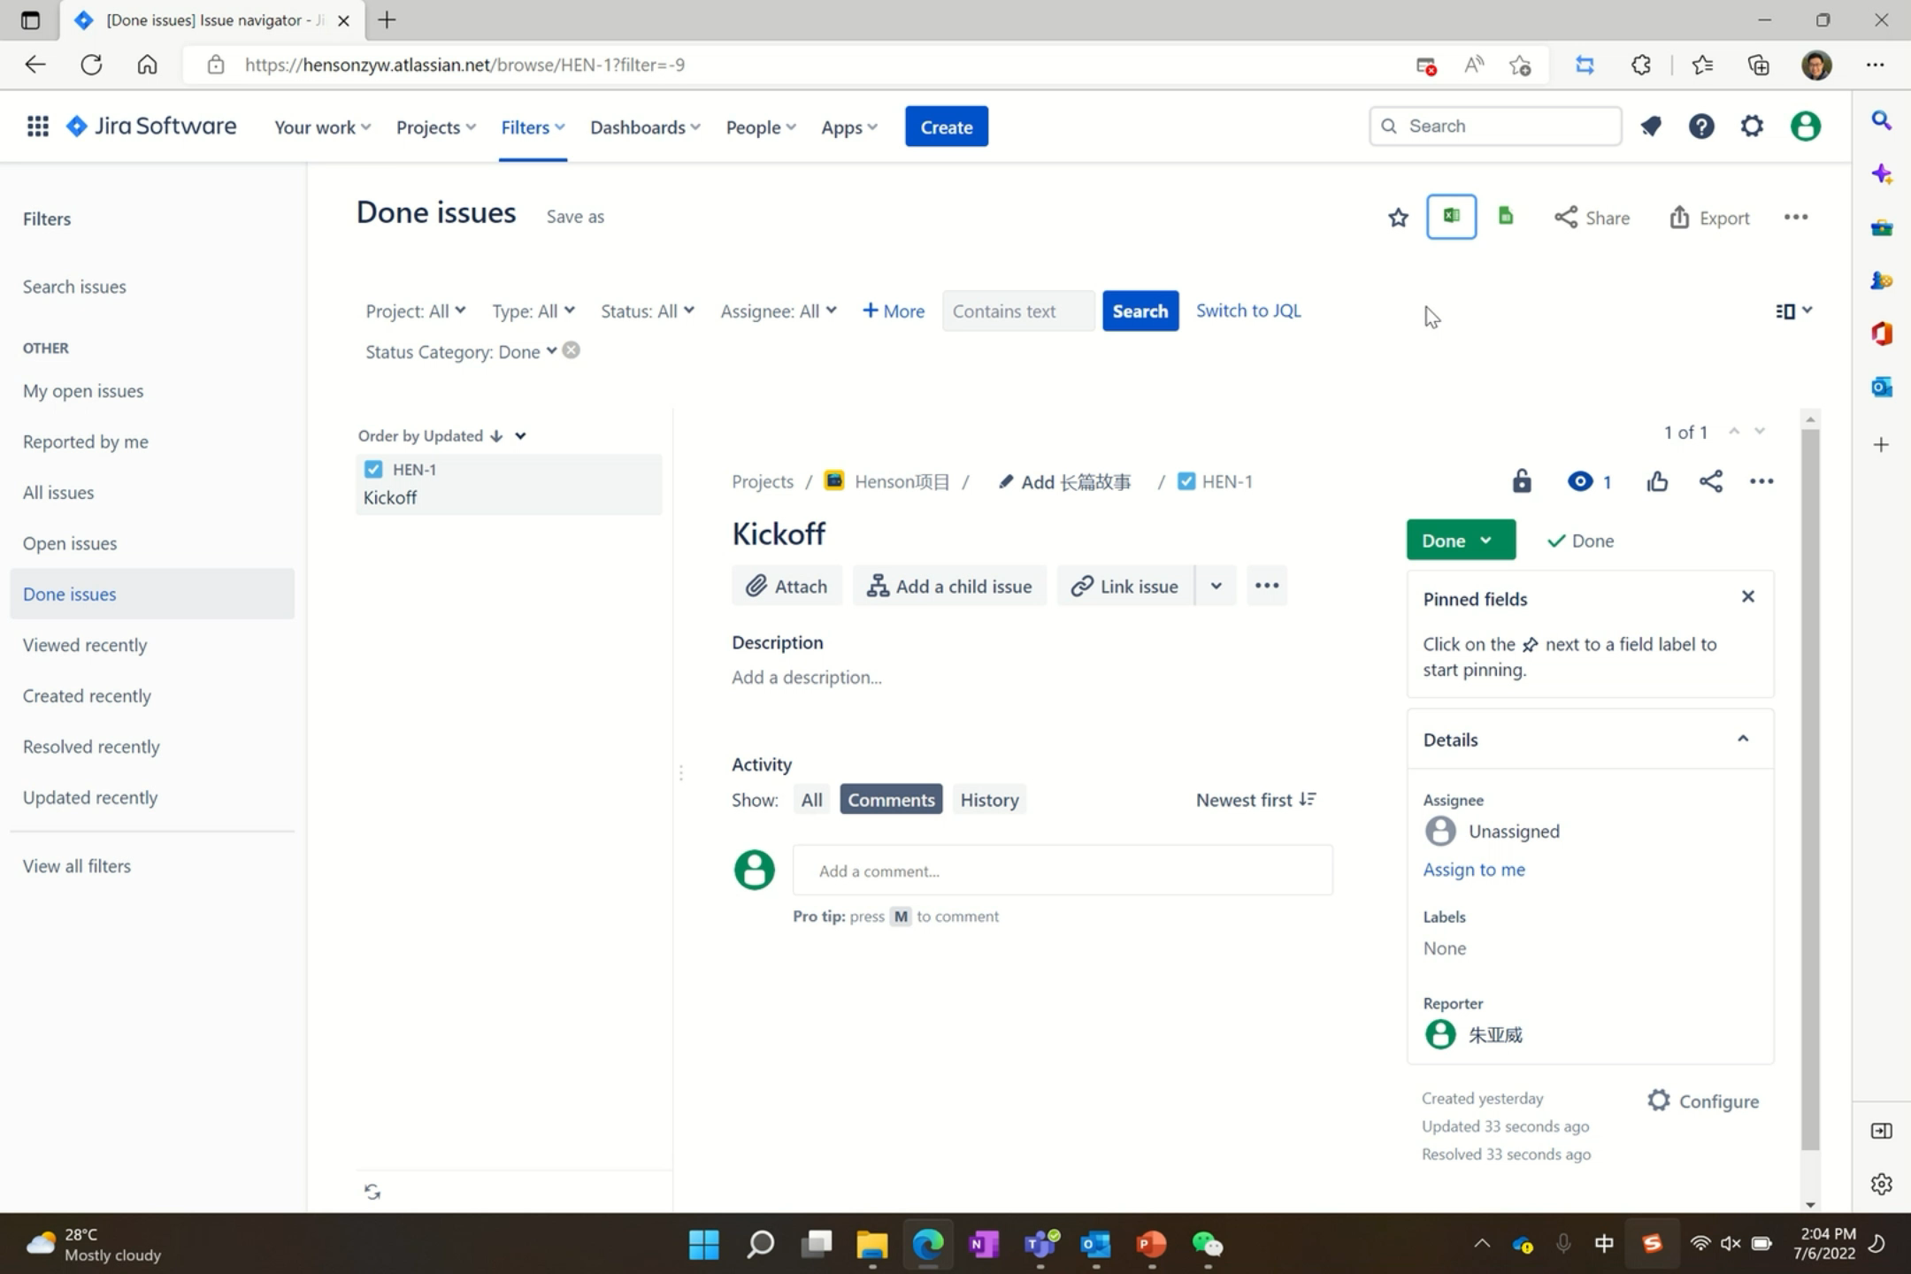
User Pattern – Open in Excel Desktop Client

Slide 7
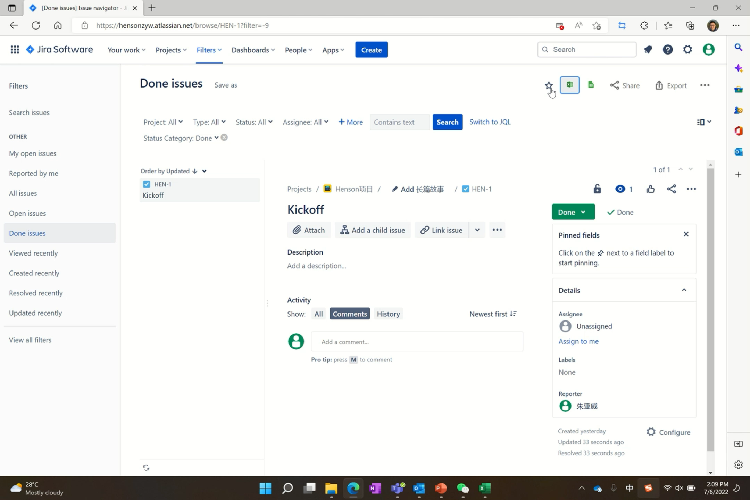
User Pattern – Open in Excel Online

Slide 8
Benefit & Value
This pattern will bring clear value to both user and developer
To user
Better experience
Smooth workflow, no need to install add-in from store first
To add-in developer
Better funnel
Add-in can be launched automatically, no user friction
Better link
Stay in link with users when they jump out to Excel
Better user awareness
Sharing the file will let other related users launch the add-in automatically as well
Better usage

Slide 9
When to Use It
User can export data from your system to Excel
Any system: ERP, CRM, Finance, BI, EDU, etc.
Export data from your system to Excel is a common activity of user
Your Excel JS add-in integrate your service with Excel
Use your add-in to stay in connection with your system data
More actions
Data analysis & visualization
Data write back
Etc.

Slide 10
How to Use it
PnP Sample Code for Easy Start
Open Excel from your web page and embed your Office Add-in - Office Add-ins | Microsoft Docs
When User’s Store is Disabled
If the store is disabled by the tenant admin, developer can reach the admin to central deploy the add-in with Microsoft admin center to their end user first. Then, when users open Excel from your system/product, they will be able to use the add-in directly.
Deploy add-ins in the admin center - Microsoft 365 admin | Microsoft Docs
Running on Background
Configure shared runtime to let add-in can be still running when user closes the side panel if you need to keep the connection between Excel and your system consistent.
Configure your Office Add-in to use a shared JavaScript runtime - Office Add-ins | Microsoft Docs

Slide 11

Thank You!
yaweizhu@microsoft.com
Feedback Forms: https://forms.office.com/r/14KL0MjPfJ

Slide 12
OOXML libraries demo
Thomas Barnekow: Senior Principal Architect

Slide 13
Using Linq to XML in Office.js Add-ins
Office Add-in Community Meeting
August 10, 2022
Dr. Thomas Barnekow
thomas.barnekow@dokumate.com
https://dokumate.com

Slide 14
Your Speaker: Thomas Barnekow
Not Quite the Typical Software Engineer
Analog Devices (since Aug 2022): Senior Principal Architect
Dr. Thomas Barnekow (since May 2017): Developer of DokuMate (see https://dokumate.com)
22 years in management consulting and outsourcing sales
ISG: Senior sourcing advisor and thought leader, EMEA sourcing capability lead, advised and led several multi-billion USD outsourcing deals
IBM: Outsourcing deal maker for large IT infra deals
Accenture: Outsourcing “market maker” for large application deals, IT management consulting
McKinsey: IT management consulting
Fraunhofer: Member of Software Technology Competence Center and Ph.D. thesis
Open-Source Developer
Significant open-source contributions in the Open XML space: Open XML SDK and Open XML PowerTools
Developer of TypeScript libraries for dealing with Open XML markup (see https://github.com/OpenXmlDev)
@openxmldev/linq-to-xml – Think LINQ to XML in .NET
@openxmldev/linq-to-ooxml – Namespace-related classes
linq-add-in – Demo Office.js add-in

Slide 15
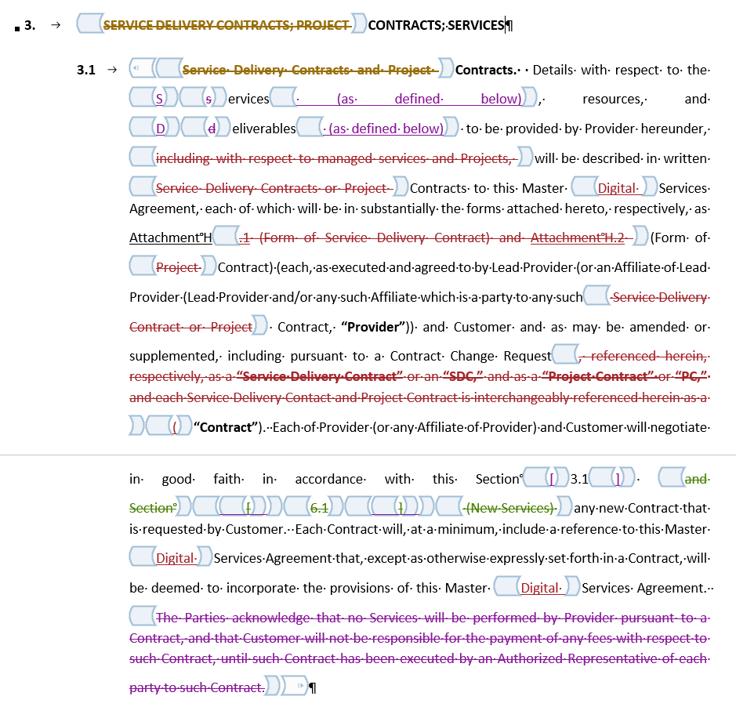
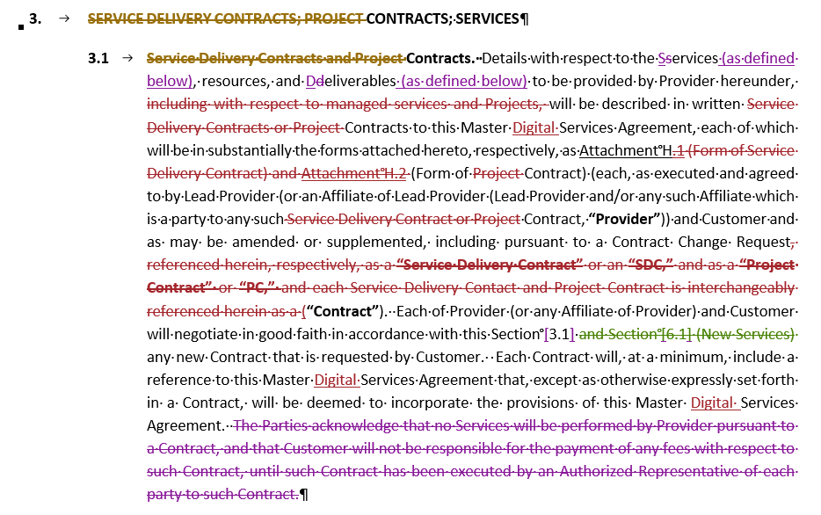
Let’s consider a simple use case in which we need to clean up a Word document that contains a massive number of content controls (w:sdt elements)
Transform
Transformed version without w:sdt elements
Original version with
w:sdt elements highlighted in Design Mode

Slide 16
Looking at a simplified excerpt of the Open XML markup, we can see how w:sdt elements are nested
Open XML Markup with Nested w:sdt Elements
<w:document xmlns:w="http://schemas.openxmlformats.org/wordprocessingml/2006/main">
<w:body>
<w:sdt>
<w:sdtContent>
<w:p>
<w:sdt>
<w:sdtContent>
<w:sdt>
<w:sdtContent>
<w:ins w:id="82" w:author="Author One" w:date="2022-02-25T09:09:00Z">
<w:del w:id="83" w:author="Author Two" w:date="2022-02-25T12:29:00Z">
<w:r w:rsidR="00324C55">
<w:delText>]</w:delText>
</w:r>
</w:del>
</w:ins>
</w:sdtContent>
</w:sdt>
</w:sdtContent>
</w:sdt>
</w:p>
</w:sdtContent>
</w:sdt>
</w:body>
</w:document>
Block-level w:sdt for sample paragraph consists of 816 lines of Open XML markup
Transformed Open XML Markup
<w:document xmlns:w="http://schemas.openxmlformats.org/wordprocessingml/2006/main">
<w:body>
<w:p>
<w:ins w:id="82" w:author="Author One" w:date="2022-02-25T09:09:00Z">
<w:del w:id="83" w:author="Author Two" w:date="2022-02-25T12:29:00Z">
<w:r w:rsidR="00324C55">
<w:delText>]</w:delText>
</w:r>
</w:del>
</w:ins>
</w:p>
</w:body>
</w:document>
This excerpt represents a “]” that was first inserted and then deleted

Slide 17
The Open XML SDK unlocks several options for transforming Open XML markup in a purely functional way, including XSLT stylesheets and Linq to XML
Transformation with XSLT Stylesheet
Transformation with LINQ to XML
<?xml version="1.0" encoding="utf-8"?>
<xsl:stylesheet version="1.0" xmlns:xsl="…" xmlns:w="…">
<xsl:output method="xml" indent="yes"/>
<!-- Recursively remove all content controls (unwrapping content) -->
<xsl:template match="w:sdt">
<xsl:apply-templates select="w:sdtContent/node()" />
</xsl:template>
<!-- Perform identity transformation on everything else -->
<xsl:template match="@* | node()">
<xsl:copy>
<xsl:apply-templates select="@* | node()"/>
</xsl:copy>
</xsl:template>
</xsl:stylesheet>
private static object RemoveSdtsTransform(XNode node)
{
return node switch
{
XElement element when element.Name == W.sdt =>
element.Element(W.sdtContent)?
.Nodes()
.Select(RemoveSdtsTransform),
XElement element =>
new XElement(element.Name,
element.Attributes(),
element.Nodes()
.Select(RemoveSdtsTransform)),
_ => node
};
}
Leverage WordprocessingDocument.ToFlatOpcDocument() etc. and System.Xml.Xsl.XslCompiledTransform class
Leverage DocumentFormat.OpenXml.Linq (XName properties of W class) and System.Xml.Linq classes such as XNode and XElement

Slide 18
With the @openxmldev/linq-to-xml and @openxmldev/linq-to-ooxml packages, you can now use the same approach in TypeScript and Office.js add-ins
@openxmldev/linq-to-xml package implements LINQ to XML for TypeScript
See https://github.com/OpenXmlDev/linq-to-xml
See https://www.npmjs.com/package/@openxmldev/linq-to-xml
@openxmldev/linq-to-ooxml package provides namespace-related classes (e.g., W, W14)
See https://github.com/OpenXmlDev/linq-to-ooxml
See https://www.npmjs.com/package/@openxmldev/linq-to-ooxml
linq-to-xml sample add-in shows how to use the above libraries: https://github.com/OpenXmlDev/linq-add-in
When to Use
You have previous experience with Open XML or even C# code you could port to TypeScript
The Office.js API does not provide adequate support for your use case

Slide 19
DEMO

Slide 20
Thank You

Slide 21
Community engagement update
Linda Cannon: Senior Content Product Manager

Slide 22








Challenge: many channels and types
Note this does not include legitimate service issues or outages, nor does it cover paid services for Premium support. This covers free support developers can find across our many channels. The types are:
Product ideas or feature requests
Product bugs
Troubleshooting or help with code (how-to) requests
Requests for docs or samples
Mix of Contact Types
idea | bug | how-to | docs
5% | 45% | 45% | 5%
Volume per week
?
50
10
>100
>100
50
Primary Channels
Premium Customer Support (CSS)
GitHub
Feedback
(was UserVoice)
In-product feedback
Stack Overflow
Microsoft Q&A
Multiple re-direction where necessary
Extended Work Tracking
Issue
Feature suggestion
ICM / OCV
Ticket
Bug or backlog item

Slide 23
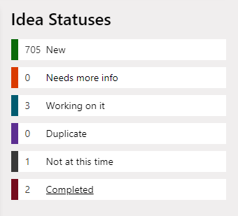

Problem to solve: What happens to customer suggestions/ideas?
Since UserVoice retired in 2021, we’ve asked customers to go to https://aka.ms/m365dev-suggestions (on Tech Communities) to submit ideas or vote on them.
Added to weekly Feedback Process Coordinator process to triage.
This was a temporary solution until the Feedback Portal shipped.
We currently have 650+ new ideas. Most of these have not been triaged, however many have multiple upvotes.
We also have 16 open issues in GitHub office-js labeled product feature request.

Slide 24
What is the problem to be solved?
Send customers to new Feedback portal or keep in GitHub?
Feedback portal | GitHub office-js
Official One Microsoft solution Can upvote Searches for possible dupes | Homegrown solution Can customize Can upvote Discussions Customers prefer this because it is triaged daily Can attach logs, screenshots, etc.
Product centric, not platform No forum for Office or office-js “Feedback” is a big bucket includes all contact types (bugs, ideas, how-tos, Docs) Another place to triage where we’ll be unresponsive due to resource constraints We only have one OCV bucket (Extensibility) so no way to integrate No customization, no file attachments | Difficult to know who to assign issues Growing list of issues in backlog Integrating with ADO for bugs is possible but requires a resource to develop it Also, it is possible to create PowerBI reports but requires a resource
Pros
Cons
Notes:
Either site, we need to figure out workflow to migrate content from TC.
Product centric means it’s only top level products which is why Graph and SharePoint fit but Office development doesn’t.
Currently only 49 forums
Docs is capitalized because now Docs feedback dumps here
GitHub comes with its own set of problems/issues but at least we own it

Slide 25
Your feedback matters
Where we're at now: Feature spec has been submitted requesting we change to GitHub. Note this decision is not final, the ETA is end of this month.
Please review the new Feedback Portal vs. GitHub issues and send your thoughts to the channel or email me directly lindalu@microsoft.com with "Office Add-ins feature suggestions" as email subject.
If you have any suggestions that you submitted to the current forum on Tech Communities, please @lindalu-msft in the comments so I can prioritize triaging your submission!
If you are interested in participating in a future User Research session about customer support channels, please let me know. Email me lindalu@microsoft with "Office Add-ins Developer User Research" as email subject.

Slide 26
Outlook API update
Mailbox 1.12 Scope Defined
REST Decommission Update and FAQ
Juan Balmori: Principal Product Manager

Slide 27
Mailbox 1.12 Scope

Slide 28

Mailbox 1.12 Scope defined
Smart Alerts
OnMessageSend
OnAppointmentSend
New Compose events
OnMessageCompose
OnAppointmentOrganizer

Slide 29
Outlook Smart Alerts in a nutshell
Event-based activation feature that allows logic to run after a user clicks “Send” from an ​Outlook message or appointment.
Activated by the OnMessageSend and OnAppointmentSend events.
Sample scenarios include:
Verifying that the correct signature is used.
Verifying that a sensitivity label is applied.
Verifying that the correct color categories are applied.
Feature is currently in preview on Windows and OWA!
Will be accepted in the store!

Slide 30
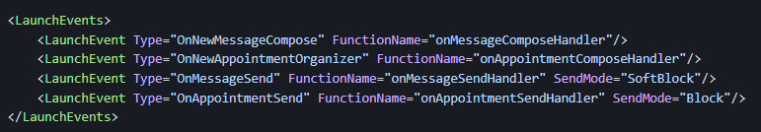
Key parts of the manifest
Uses the <LaunchEvents> element in the manifest.
Three SendMode options available.
PromptUser – use it for recommended changes (provides a “Send Anyway” option)
SoftBlock – use it for mandatory changes: Does not provide an Option to “Send Anyway” except if add-in is unavailable.
Block – use it for mandatory changes and will not allow send if add-in unavailable (will not be allowed in store)

Slide 31
Outlook V2 Decommission Update

Slide 32
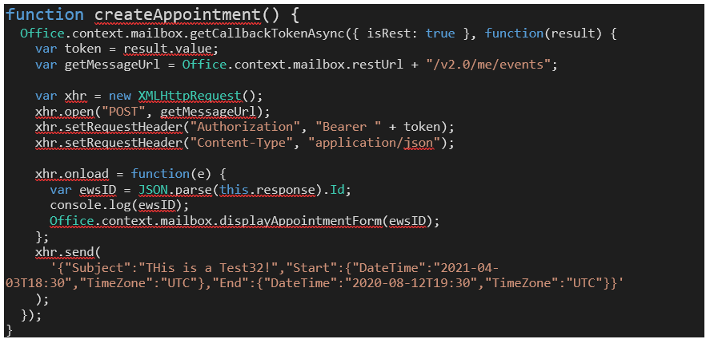
Some Context: Back in February we shared:
On Nov 30^{th,} 2022, the Outlook REST V2 Endpoint will be decommissioned.
Impacts Exchange Online, and Exchange OnPrem on Hybrid.
Scenarios impacted
Using the REST APIs
Delegate Scenarios using REST

Slide 33
Where we are?
Good news: all active Add-ins using REST will be granted exceptions to keep using the service until Office 2019 goes out of support (October 14,2025) ​
We will automatically ID traffic coming from Add-ins.
Currently testing will all partners who sent RESTCheck. Looks good!
Participate on Validation? Please send https://aka.ms/RESTCheck
Move to Graph ASAP
PLEASE share any issues you find. (either graph scope or non functional issues like perf.)

Slide 34
When the Outlook REST API is decommissioned will there be any programmatic way to confirm at add-in runtime that the REST API is not usable by the add-in?
There are some scenarios where the add-in could still use the REST API and we want to be able to know those.
e.g. Code that an add-in which has had its ID registered on the Microsoft form, an add-in using the REST API of Exchange 2016 (which does exist and does work, have confirmed this against customer deployments).
For example, what will Office.context.mailbox.restUrl return after Outlook REST API is decommissioned?

Slide 35
Solution for Mobile?
1. Our Add-in used the REST API on mobile devices. We have no facility to run server-side code for the add-in to support the Graph SSO flow to achieve the same experience with that API.
Given this, we were wondering if we could use getCallbackTokenAsync on mobile to retrieve a token usable with EWS? Can you confirm this is possible? Then we could issue the API requests manually to EWS client-side instead of through makeEwsRequestAsync (not available on mobile).
2. Can we get examples of using Outlook add-ins on mobile with an alternative to the REST API? The add-in documentation still refers to using the REST API on mobile - https://docs.microsoft.com/en-us/office/dev/add-ins/outlook/outlook-mobile-addins

Slide 36
More mobile questions
Can we get some documentation/guidance on how to update mobile add-ins to work post REST API decommissioning?
getAccessToken for use with Graph isn't available in the requirement set supported by Outlook on iOS or Android.
getCallbackToken will return an EWS token but it only works for GetItem and GetAttachment, so add-ins that were accessing operations other than those e.g. FindFolders, won't work with that approach.
Is there an available migration option here for an add-in that uses operations beyond GetItem and GetAttachment (that doesn't force user popups where previously there were none)?

Slide 37
Using REST in OnPrem?
The Outlook REST API has been available in Exchange 2016 since CU3 (and is also in Exchange 2019). However all talk of decommissioning of the REST API seems to be around O365. Are on-premise Exchange installs also going to be impacted by the decommissioning? Or will the REST API remain available there?
Note: Previously it was stated on a call that Exchange 2016/2019 does not support REST API, I've provided a Microsoft article below stating it is supported from 2016. Also we have customers using Exchange 2016 and the REST API with our add-ins and I've used it myself against our lab Exchange environment
https://techcommunity.microsoft.com/t5/exchange-team-blog/on-premises-architectural-requirements-for-the-rest-api/ba-p/605609

Slide 38
Word add-ins survey
Please take a few minutes to fill in the survey, which we'll use as an input for prioritizing future work. Thank you!
aka.ms/wordAPI

Slide 39
Question:
Is there a way to stop the mouse cursor icon changing to a loading icon when calling the 'Powerpoint.run()' function in an office add-in?
Answer:
This behavior is by design because Office JS APIs run on PowerPoint’s UI thread. The user is unable to interact with PowerPoint until API operations are complete. If an operation takes a bit longer than usual, the cursor change informs the user they are temporarily blocked.
Q&A

Slide 40
Question:
When performing a search using Microsoft Graph, preferably using the '/search(q='${searchText}' endpoint, is it possible to search SharePoint files by their 'ImageTags'?
Answer:
We recommend you follow up with the Microsoft Graph team at https://docs.microsoft.com/answers/products/graph
Q&A

Slide 41
Question:
Is there a way to start a web addin (open the web task pane) from a VSTO add-in? This capability would make the transition from VSTO to web much easier to implement some functionality in a web add-in and have a smooth transition from VSTO to web as if it was a single add-in. Migrating the entire add-in from VSTO to web in a big bang is not possible since the JS api is lacking some COM APIs.
Answer:
No this capability does not exist. There are resources available for this scenario though. Please see https://docs.microsoft.com/en-us/office/dev/add-ins/develop/make-office-add-in-compatible-with-existing-com-add-in and https://docs.microsoft.com/en-us/office/dev/add-ins/tutorials/migrate-vsto-to-office-add-in-shared-code-library-tutorial
Q&A

Slide 42
Question:
How can we create new prepopulated emails from a web add-in hosted by another Office application? E.g. have a button in a Word add-in to create an email with subject and body already set and the Word document attached (as pdf, maybe with some pdf manipulation in between) as well. Something like this was possible with VSTO add-ins but I can't find a solution with web add-ins.
Answer:
If the goal to attach the currently open document as a PDF, then in that case you can use the Office.document getAsync API. See https://docs.microsoft.com/en-us/javascript/api/office/office.document?view=word-js-preview#office-office-document-getfileasync-member(2)
Unfortunately there isn't direct way to send the email from the Word add-in. You can open a dialog box using the Office dialog API. Then use Microsoft Graph mail API to construct and send the email with the PDF attached.
Q&A

Slide 43
Question:
With VSTO it is possible to create PDF/A versions of Office files. In our target sector (public sector, governments) using PDF/A is important and required in most cases. How can a PDF/A representation of an office file can be created using the JS APIs?
Answer:
Unfortunately Office JS only supports the PDF format right now. This would be a great feature request. Please let us know more at https://aka.ms/m365dev-suggestions
Q&A

Slide 44
Question:
Regarding GitHub issue: Sharing Excel Workbooks dependent on Add-ins can cause irrecoverable corruption. This also relates to the Open in Excel functionality. There is no practical workaround. We were advised to submit a request for resolution to the Microsoft 365 Developer Platform. We submitted the "idea" on June 1 but have received no upvotes or responses so far. We were informed "the PM team will consider it at the Quarterly planning." What are the dates of the last and next Quarterly planning meetings? Why do critical breaking issues need to be posted on an "ideas forum"? When can we expect to see a response from Microsoft?
Answer:
We apologize for the time it is taking to investigate this issue. There is some nuance to how an add-in is activated when embedded in a document. We are validating the different scenarios here and will follow up on the GitHub issue this week.
Q&A

Slide 45
Outlook Question:
We have customers asking for more control over the sizing and positioning of our add-in in Outlook. Particularly the new versions of Outlook where the size of the add-in icon has been decreased and it can be pushed into a sub-menu, customers want to be able to make the add-in button more prominent for their users (automatically across an organization). Is there any work being done in this area?
Outlook Question:
Is it possible to create an OWA add-in that will replace/augment the public location suggestions when creating a Calendar Appointment?
Currently it shows results using Bing, and I'd like to create an add-in that would bring in results from a different source.
Answer:
We’ll provide an answer in the blog post following the call.
Q&A

Slide 46






New to Office Add-ins?
 | Documentation | https://aka.ms/office-add-ins-docs
 | Quick starts | Outlook, Excel, Word, PowerPoint
 | Script Lab | https://aka.ms/getscriptlab
 | Samples | https://aka.ms/officeaddinsamples
 | Microsoft 365 Developer Program | https://aka.ms/M365devprogram
 | Office Scripts | aka.ms/office-scripts-docs
Notes:
m365-dev-sig

Slide 47
Engage with the team
Engagement | Where to go
Technical questions about Office Add-ins | https://aka.ms/office-addins-dev-questions [office-js-dev] [office-addins-dev] https://stackoverflow.com [office-js] [outlook-web-addins] [office-scripts]
Product bugs | https://github.com/OfficeDev/office-js
Feature requests and ideas | https://aka.ms/m365dev-suggestions
Send a Smile or Frown | Inside Office
Notes:
m365-dev-sig

Slide 48
Microsoft 365 developer community calls
Microsoft 365 platform call (weekly) https://aka.ms/m365-dev-call (Notice. This call is on a summer break between July 1st and 31st of August 2022)
Adaptive Cards (monthly) https://aka.ms/adaptivecardscommunitycall
Microsoft identity platform (monthly) https://aka.ms/IDDevCommunityCalendar
Office Add-ins (monthly) https://aka.ms/officeaddinscommunitycall
Power Platform (monthly) https://aka.ms/PowerPlatformMonthlyCall
Microsoft 365 & Power Platform Development (bi-weekly) https://aka.ms/m365-dev-sig
Viva Connections &
SharePoint Framework (bi-weekly) https://aka.ms/spdev-spfx-call
All calls and assets: https://aka.ms/m365pnp
Notes:
m365-dev-sig

Slide 49
Thank you
Recording will be available in 24 hours on
Microsoft 365 Community (PnP) YouTube channel
https://aka.ms/M365PnP/videos
(subscribe today)
Follow us on Twitter
@Microsoft365Dev | @M365PnP
Next call: September 14th at 8:00 AM Pacific Time
https://aka.ms/officeaddinscommunitycall
Agenda: https://aka.ms/officeaddinsagenda
Submit your questions: https://aka.ms/officeaddinsform

